Slide 1
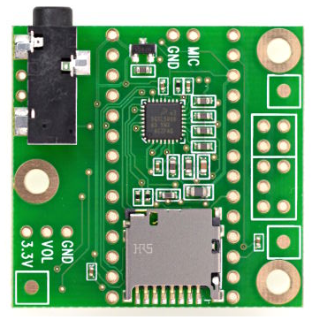
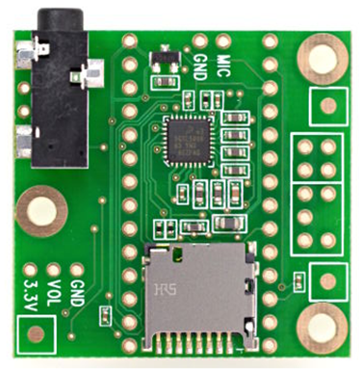
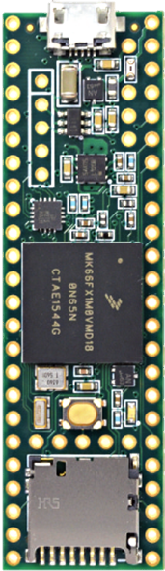
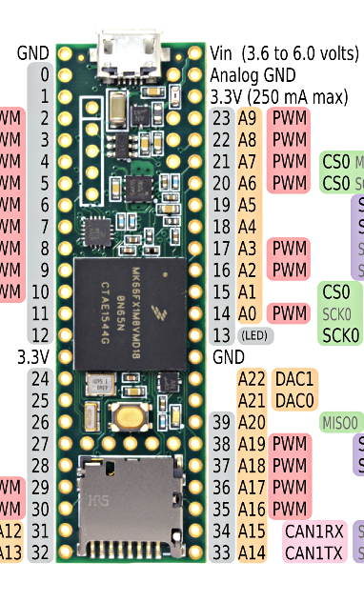
Existing COTS Hardware
Teensy 3.6
Dev Board
Teensy
Audio Board
Teensy
Audio Stack
Creare seeks to replace the Teensy Audio Board
with a new Creare Audio Board

Slide 2


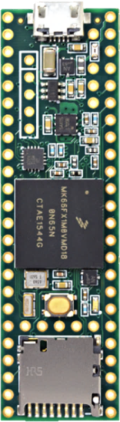

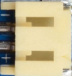

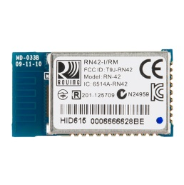
Creare Audio Board (“Tympan A”)
Notional Layout
Creare
Audio Board
With Teensy 3.6
Mounted
J2
Hole
J1
U2 (Codec) on Bottom to shield from Teensy 3.6?
Keep leads to J2 short!
J2
Hole
J1
D7
D6
D7
D6
U2
U2
OFF
OFF
U23
J6
Power Supplies can go anywhere
U23
J6
ON
U24
ON
U24
IN3
L
J1
IN3
L
J1
~9.5 cm
R
R
IN2
L
IN2
L
Line-O
R
Should we consider SMT versions of these headers so that the RN42 module can be slid underneath (on the back side of the PCB)?
Line-O
R
L
J5
L
J5
G
+
R
G
+
R
D11
D10
D11
D10
R19
R19
D5
4-40 Clearance Holes (Free Fit)
D5
Teensy 3.6: 61Lx18W mm
~3.7cm
This RN42 Bluetooth module is too big to fit between the headers, so I put it here…sticking out. I’m not a big fan of this location because it makes the PCB much longer. But what other location is better?
RN42: 25.8L x 13.4W mm
4-40 Clearance Hole (Free Fit)
Codec: 5.15 x 5.15 mm
Battery Connector. 9mm W

Slide 3
Rev 2016-12-05 1pm
Creare Audio Board (“Tympan 1”)
Notional Layout
Creare
Audio Board
With Teensy 3.6
Mounted
J2
Hole
J1
U2 (Codec)
Keep leads to J2 short!
J2
Hole
J1
D7
D6
D7
D6
U2
Mics
Right-Left
U2
Mic
R
U23
Mic
L
Mic
R
U23
Mic
L
OFF
Power Supplies can go anywhere
OFF
U24
J6
U24
J6
~9.75 cm
ON
ON
IN3
L
IN3
L
Line-O
R
Line-O
R
L
L
G
+
R
G
+
R
J5
J5
R19
R19
D11
D10
D5
4-40 Clearance Holes (Free Fit)
D11
D10
D5
TYMPAN 1
TYMPAN 1
Teensy 3.6: 61Lx18W mm
~3.7cm
RN42: 25.8L x 13.4W mm
4-40 Clearance Hole (Free Fit)
Codec: 5.15 x 5.15 mm
Battery Connector. 9mm W

Slide 4
Rev 2016-12-05 3pm
Creare Audio Board (“Tympan 1”)
Notional Layout
Creare
Audio Board
With Teensy 3.6
Mounted
J2
Hole
J1
U2 (Codec)
Keep leads to J2 short!
J2
Hole
J1
D7
D6
D7
D6
U2
Mics
Right-Left
U2
Mic
R
U23
Mic
L
Mic
R
U23
Mic
L
OFF
Power Supplies can go anywhere
OFF
U24
J6
U24
J6
~9.75 cm
ON
ON
IN3
L
IN3
L
Line-O
R
Cut-away to allow wiring from J6 to go to the battery underneath
Line-O
R
L
L
G
+
R
G
+
R
J5
J5
R19
R19
D11
D10
D5
4-40 Clearance Holes (Free Fit)
D11
D10
D5
TYMPAN 1
TYMPAN 1
Teensy 3.6: 61Lx18W mm
~3.7cm
RN42: 25.8L x 13.4W mm
4-40 Clearance Hole (Free Fit)
Codec: 5.15 x 5.15 mm
Battery Connector. 9mm W

Slide 5
Rev 2016-12-06 12:50pm
Creare Audio Board (“Tympan 1”)
Notional Layout
Creare
Audio Board
With Teensy 3.6
Mounted
J5
Hole
J10
U4 (Codec)
Move as desired, but keep leads to J5 short!
J5
Hole
J10
D1
D2
D1
D2
Mic2:
“Right” Mic
U4
Mic1: “Left” Mic
U4
Mic
R
U2
Mic
L
Mic
R
U2
Mic
L
OFF
Power Supplies can go anywhere
OFF
SW1:
Power
U3
J4
U3
J4
ON
Battery
Connector
ON
IN3
L
IN3
L
~9.75 cm
Line-O
R
Line-O
R
L
L
G
+
R
PCB Cut-away to allow wiring from J6 to go to the battery underneath
G
+
R
J6
J6
R6
Pot
R6
Pot
D4
D5
D3
4-40 Clearance Holes (Free Fit)
D4
D5
D3
TYMPAN 1
TYMPAN 1
Teensy 3.6: 61Lx18W mm
Note: The battery will go underneath, so please keep components on the bottom to a minimum to prevent interfering with the battery.
RN42: 25.8L x 13.4W mm
~3.7cm
4-40 Clearance Hole (Free Fit)
Codec: 5.15 x 5.15 mm
Battery Connector. 9mm W

Slide 6
Extra Art

Slide 7
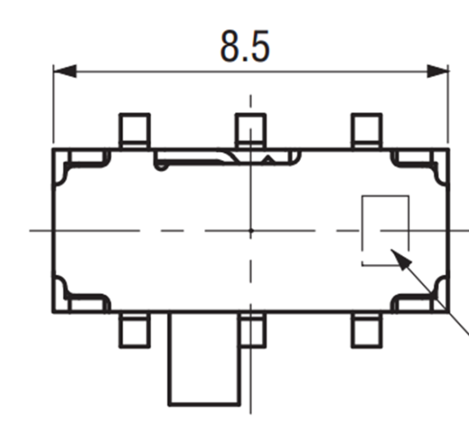

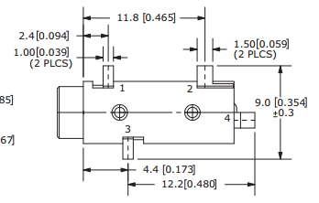
Headphone Jack
Outer Env:
L = 2.5+4.4+12.2=19.1 mm
W = 9.0 mm

